Slide 1
Chapter One
Event Driven Programming

Slide 2
Contents
Define Event Driven Programming
What is an event?
Properties of events.
Microsoft .NET
C# Language
Build your first application

Slide 3
Event Driven Programming Defined
An event, in the context of computer systems, is an action or an occurrence that is significant to a systems hardware or software.
Events can either be user-generated such as keystrokes and mouse clicks or system-generated such as program loading and running out of memory.
Therefore an event driven program is a program that responds to user initiated events clicks, keystrokes, finger swipes.
A method that handles these events in known as EventHandler.

Slide 4
Cont.
Events enable a class or object to notify other classes or objects when something of interest occurs.
The class that sends (or raises) the event is called the publisher.
The classes that receive(handle) the event are called subscriber.
In a typical C# Windows Forms application or Web application, you subscribe to events raised by controls(User Interface elements) such as buttons, checkboxes, radio buttons etc.
You can use the Visual C# integrated development environment (IDE) to browse the events that a control publishes and select the ones that you want to handle.
Controls are the publishers and the event handlers are the subscribers.

Slide 5
Properties of Events
The publisher determines when an event is raised; the subscribers determine what action is taken in response to the event.
An event can have multiple subscribers. A subscriber can handle multiple events from multiple publishers.
Events that have no subscribers are never raised.
Events are typically used to signal user actions such as button clicks or menu selections in graphical user interfaces.
In the .NET class library, events are based on the EventHandler delegate and the EventArgs base class.
A delegate is an object which refers to a method.
An EventHandler delegate connects the event source to the event handler code.

Slide 6
Console Apps vs GUI Apps
There are significant differences between Console Applications and Graphical User Interface Applications.
Console applications call on the operating system to perform certain functions such as inputting or outputting data.
GUIs are Windows applications that are highly interactive and have interfaces that are easy on the eyes. The program registers its events with the operating system and waits until an event occurs.
When the event occurs, Windows applications receive messages from the operating system that an event has occurred. You write methods called event handlers to indicate what should be done when an event such as a mouse click on a button or the press of a key occurs.

Slide 7
Cont.
Unlike console-based applications that exit after all statements have been sequentially executed, Windows-based applications, after they are launched, sit idly waiting for notification of a registered event. The program remains in the operating system environment in a process loop.
Another important difference in a Windows application is that unlike the sequential nature you can plan on with console-based applications, in which one statement executes and is followed by the next, no sequential order exists with event-handling methods for Windows applications.
If you have many options (buttons), you do not know which one the user will click first or whether any of them will be clicked.

Slide 8
MICROSOFT .NET

Slide 9
History of .NET
In 2000, Microsoft announced its .NET initiative (www.microsoft.com/net), a broad vision for using the Internet and the web in the development, engineering, distribution and use of software.
.NET is an environment in which programs run and was designed to be a new programming paradigm.
It is not an operating system, but rather a layer between the operating system and other applications. As such, it provides a platform for developing and running code that is easy to use. .
It contains thousands of valuable prebuilt classes that have been tested and tuned to maximize performance.

Slide 10
Flavors of .NET
.NET is cross platform, i.e. tt is not tied to a specific operating system, for instance Microsoft.
It runs on operating systems like Microsoft, MacOS and Linux
It is open source, as a result we can see the code Microsoft created for .NET.
.NET can be used to develop different sorts of applications such as
Console applications
Desktop applications
Mobile applications
Cloud applications
Games
AI powered applications

Slide 11
FEATURES OF .NET

Slide 12
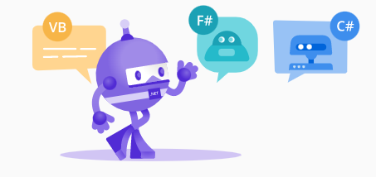
Multiple Languages
You can write .NET apps in C#, F#, or Visual Basic.
C# is a simple, modern, object-oriented, and type-safe programming language.
F# is a programming language that makes it easy to write succinct, robust, and performant code.
Visual Basic is an approachable language with a simple syntax for building type-safe, object-oriented apps.

Slide 13
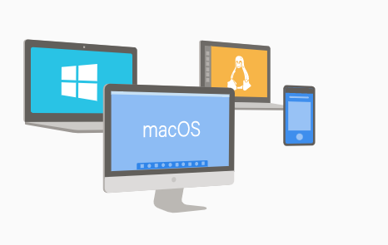
Cross Platform
Whether you're working in C#, F#, or Visual Basic, your code will run natively on any compatible operating system. You can build many types of apps with .NET. Some are cross-platform, and some target a specific set of operating systems and devices.
Xamarin and Maui apps for Android and IOS

Slide 14

One Consistent API
.NET provides a standard set of base class libraries and APIs that are common to all .NET applications.
Each app model can also expose additional APIs that are specific to the operating systems it runs on, or the capabilities it provides. For example, ASP.NET is the cross-platform web framework that provides additional APIs for building web apps that run on Linux or Windows.

Slide 15

Libraries
To extend functionality, Microsoft and others maintain a healthy .NET package ecosystem.
NuGet is a package manager built specifically for .NET that contains over 100,000 packages.

Slide 16
Development Tools

Slide 17
Integrated Development Environment(IDE)
Visual Studio .NET (VS .NET) is an IDE that allows for Rapid Action Development(RAD).
RAD is a development methodology that enables speedy delivery to customers and allows to obtain feedback.
VS.NET is a powerful and flexible IDE that makes developing .NET applications a breeze. Some of the features of VS.NET that make you productive are:
Drag and drop design
IntelliSense features
Syntax highlighting and auto-syntax cheking
Excellent debugging tools
Integration with version control software
Easy project management

Slide 18
Visual Studio Editions
Microsoft offers three different plans for VS .NEt IDE
Community Edition: free, fully-featured IDE for students, open-source and individual developers.
Professional Edition: professional developer tools, services, and subscription benefits for small teams
Enterprise Edition: end-to-end solution to meet demanding quality and scale needs of teams of all sizes(typically teams >250 PCs)

Slide 19
Components of .NET
Runtime Environment
Compiler
Libraries
Others

Slide 20
The Common Language Runtime(CLR)
The .NET Common Language Runtime(CLR) is the most important concept in .NET Framework also known as .NET Runtime.
It is a framework layer that resides above the Operating System and handles the execution of all the .NET applications.
As a result, the program we write doesn’t communicate directly with the OS but goes first through the CLR.
In .NET, programs are not compiled into executable files; they are compiled into Microsoft Intermediate Language (MSIL) files, which the CLR then executes.
he MSIL (often shortened to IL) files that C# produces are identical to the IL files that other .NET languages produce; the platform is language-agnostic.
As the name indicates the CLR provides common runtime for languages that run on the .NET platform.

Slide 21
Cont.
The CLR is responsible for maintaining the execution of all applications developed using the .NET library.
CLR is responsible for
• integrating software components written in different .NET languages, • error handling between such components, • enhanced security, • automatic memory management, compiling and more.

Slide 22
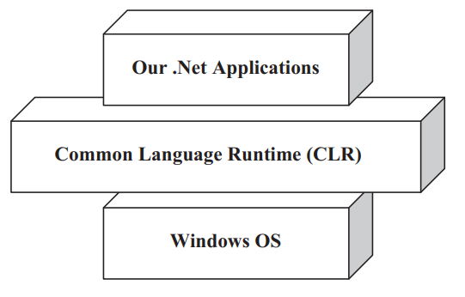

Slide 23
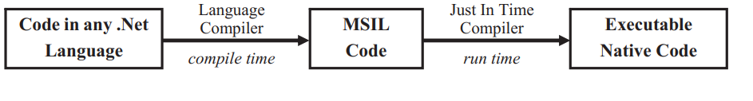
Microsoft Intermediate Language Code(MSIL)
When we compile our .NET program using any .NET compliant languages(C#,VB,F#, C++.NET) our source code does not get converted to executable code instead it is converted to an intermediate code called MSIL.
MSIL is hardware and software independent. Upon execution the MSIL is converted to binary executable code(Native code).
Cross language relationship is possible because the MSIL for every language in .NET is the same.

Slide 24
Just in Time Compilers(JITers)
When our Intermediate Language(IL) compiled code needs to be executed, the CLR invokes the Just In Time compiler.
JITers differ from traditional compilers as they compile the IL to native code only when desired hence the name JUST IN TIME.
For instance when a function is called the IL of the function body is compiled just in time. So the rest of the code that’s not called during that program run is not compiled to native code.
In addition, then converted IL code is reused the next time it is needed by the CLR without the need of re-compiling.
JITers optimize code efficiently resulting in robust applications.

Slide 25
Recap of compilation in .NET
When you build your project C# code is compiled to MSIL
The IL is saved in a file on the hard disk.
When you run your program the IL is compiled again, using the JIT.
JIT compiler analyzes the IL and produces highly efficient machine code, which runs very fast.
The JIT compiler is smart enough to recognize when the code has already been compiled, so as the application runs, compilation happens only as needed.
As .NET applications run, they tend to become faster and faster, as the already compiled code is reused.

Slide 26
The Framework Class Library(FCL)
The .NET Framework provides a huge Framework (Base) Class Library for common usual tasks
FCL has thousands of classes to provide access to Windows API and common functions such as
String Manipulation
Common Data Structures
IO
Streams
Threads
The FCL followed OODesign therefore it makes access and use very simple for developers.

Slide 27
Namespaces in .NET
System – includes all common datatypes, string values, arrays and methods for data conversion.
System.Data – are used to access the database, perform commands on a database and retrieve data.
System.IO- these are used to access read and write to files.
System Windows.Forms – are used to create windows based applications using windows user interface components.
System.Web,System.Web.UI – are used to create web services and components that can be published on the web.

Slide 28
Common Language Specification(CLS)
Any programming language can join the .NET Framework so long as it fulfills the criteria. This criteria is what is known as Common Language Specification.
Provides an object-oriented model that supports the complete implementation of many programming languages
Establishes a framework that helps enable cross-language integration, type safety, and high performance code execution.
Type safety means that the compiler will validate types while compiling, and throw an error if you try to assign the wrong type to a variable.
Defines rules that languages must follow, which helps ensure that objects written in different languages can interact with each other

Slide 29
Introduction to C#

Slide 30
What is C#?
C# is a modern object-oriented, general-purpose programming language, created and developed by Microsoft together with the .NET platform.
The language is popular and well-maintained. It comes from the C programming language lineage. And that’s where it gets its name.
C# is the main language in the .NET platform.
It was introduced in the early 2000s together with .NET. The language has evolved over the years and has numerous versions, ranging from C#1.0 - C# 12.0
There is highly diverse software developed with C# and on the .NET platform: office applications, web applications, websites, desktop applications, mobile applications, games and many others.

Slide 31
Cont.
C# is a high-level language that is similar to Java and C++.
C# graphical user interfaces (GUIs) are event driven. You can write programs that respond to user-initiated events such as mouse clicks, keystrokes, timer expirations and touches and finger swipes—gestures that are widely used on smartphones and tablets

Slide 32
Chapter One: Part II
Using Common Controls
Working with Properties, Methods and Events
Building your C# Application on Visual Studio

Slide 33
Using common controls
What are Controls(GUI Controls)?
Controls are reusable components(a piece of UI that can be used in various parts of an application to build more than one UI instance.) that encapsulate User Interface(UI) functionalities and are used in client side Windows Applications.
GUI controls are objects that can display information on the screen or enable users to interact with an app via the mouse, keyboard or some other form of input (such as voice commands).

Slide 34
Cont.
How do we create GUI Controls? WinForms and WPF
Windows Forms
Windows Forms is a UI framework for building Windows desktop apps.
Windows Forms provide many ready-to-use controls. In addition it also provides the infrastructure for developing your own controls.

Slide 35
Windows Forms Controls by Function
Data display -DataGridViewControl: Provides customizable table for displaying data. For example for displaying data from the database, reports etc
Text editing – TextBox Control: Displays text entered at design time that can be edited by users at run time, or changed programmatically
Information display (read-only)- Label Control: Displays text that users cannot directly edit.
Selection from a list – ComboBox: Displays a drop-down list of items.
Menu – MenuStrip Control – creates custom menus
Commands- Button Control – starts, stops or interrupts a process.

Slide 36
Cont.
Timer and ProgressBar control: Timer control is used to control when an event is invoked. ProgressBar is used to visually monitor the progress of an operation.
Building a user control: if developers do not find a control to meet their specifications they can create their own control by inheriting from the class UserControl.

Slide 37
Control Class Properties, Methods and Events
Control Class is the base class from which controls,components with visual representation, are derived.
It has overloaded Constructors
Control() – initializes components with default value
Control(String)- initializes components with specific text
Properties:
Anchor- sets the edges of the container to which a control is bound.
BackColor- sets the background color of the control
DefaultSize – gets/sets the default size of the control
Font- gets/sets the font of the text displayed by the control
Text- Gets or sets the text associated with this control.
Name-Gets or sets the name of the control.

Slide 38
Cont.
Methods
Dispose() – releases resources used by the component
Focus() – sets input focus to the control
Show() – displays the control to the user
Hide() – conceals the control from the user
Events
Click() – occurs when control is clicked
DoubleClick()- occurs when control is double clicked
FontChange() – occurs when font of a control is changed
GetFocus() – occurs when a control receives focus

Slide 39
Controls: Text Box
Class TextBox belongs to System.Windows.Forms namespace
Constructors – TextBox() – initializes default textbox properties
Properties, anchor,font,height readonly,focused, maxlength
Methods – show(), hide(), clear(), AppendText()
Events – click(),textchanged(),keypress

Slide 40
Controls: Button
Namespace: System.Windows.Forms
Constructors –Button() initializes a new instance of a Button class
Properties- anchor, background, autosize, text, textalign
Method – dispose(),focus(), hide(), show()
Events – click(), doubleclick(),keypress,

Slide 41
Visual Studio IDE
Visual Studio is an Integrated Development Environment(IDE).
It is used for creating, debugging and running applications written in any .NET compliant programming languages.
You can create various applications in Visual Studio
Console Applications
Windows Forms Applications
Windows Presentation Foundation
Web Applications
Web services
Visual Studio offers a template for these and other types of applications.

Slide 42
Solution Explorer
By default, the Solution Explorer tool window appears as a pane in the upper-right side of the Visual Studio
The Solution Explorer provides access to all of a solution’s files.
When you open a new or existing solution, the Solution Explorer displays all the solution’s contents.

Slide 43
Toolbox
The toolbox contains the controls used to customize forms.
With visual app development you can drag and drop controls onto the Form and the IDE will write the code that creates the controls for you.
Common controls in the toolbox are:
Ponter
Button
CheckBox
Combobox
Label
ListBox

Slide 44
Review Questions
Think of a mobile, a desktop and a web app you use frequently. Write the name of the UI elements in the applications and the actions you perform on those applications.
What are the components of .NET Framework?
What is the difference between .NET and C#?
What are the kinds of applications you can build using C# and .NET?
What are namespaces? Which namespaces did you use in your lab session. And what were the classes that were included in that namespace?

Slide 45
End of Chapter 1

